Slide 1


Influencer Performance Analysis & Business Recommendations
UNIFIED MENTOR PROJECT
Project Submission by: Rakhi Chakrabarty | Date: April 2025
Email ID – rakhichakrabarty8@gmail.com
by Rakhi Chakrabarty

Slide 2
Agenda
Overview of Key Metrics
Performance Ratio Analysis
Channel-wise Performance
Follower and Likes Relationship
Top Influencers Insights

Slide 3
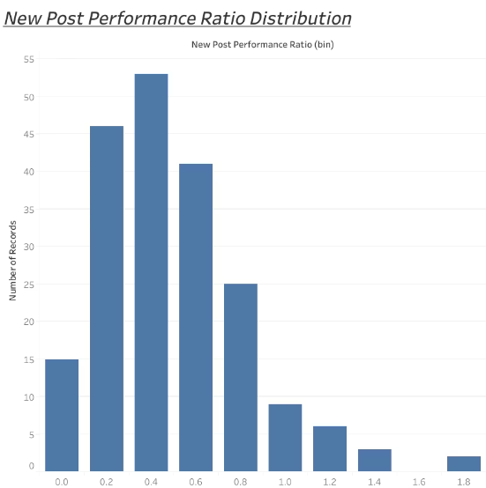
New Post Performance Ratio Distribution
Key Insights
Business Implication
Most posts have performance ratio between 0.75-1.0
Strategy effective; opportunity for more viral content
Few posts in low or viral performant brackets
Consistent engagement across content

Slide 4
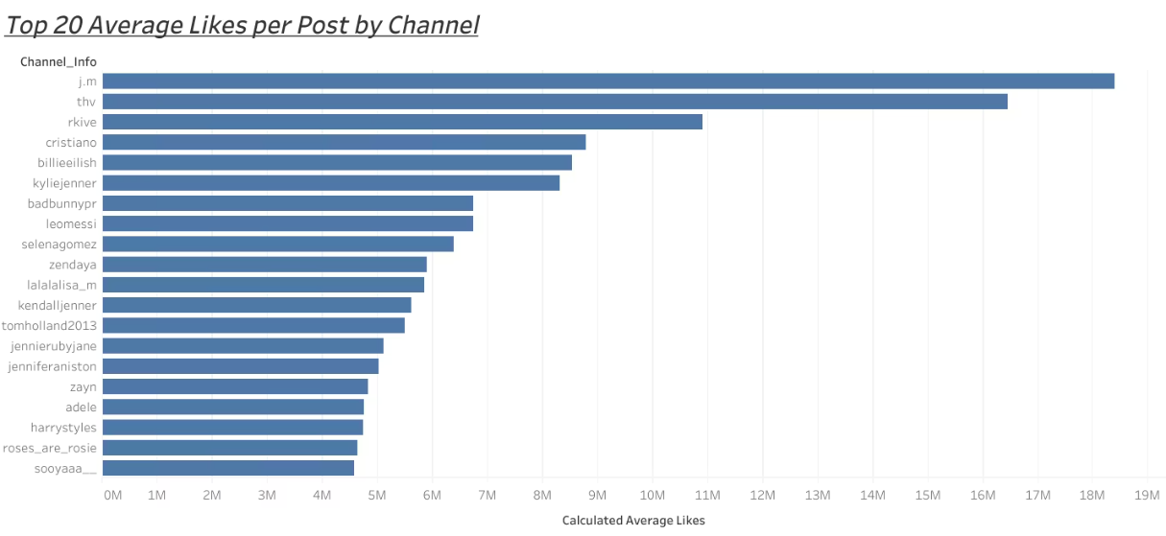
Average Likes per Post by Channel
Key Insight
Business Implication
Instagram leads with highest average likes
Focus marketing efforts primarily on Instagram
Facebook and Twitter lag significantly

Slide 5
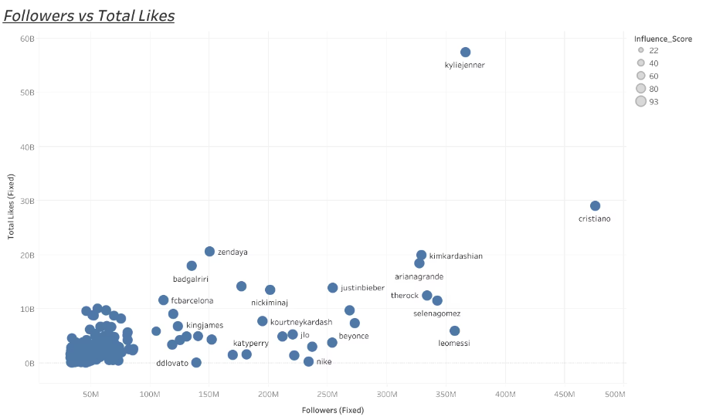
Followers vs Total Likes
Key Insights
Business Implication
Strong positive correlation between followers and likes
Engage "high-efficiency" influencers for better ROI
Some influencers exceed expected engagement

Slide 6
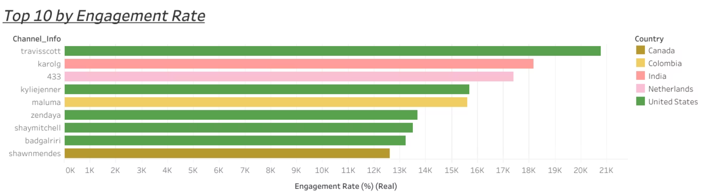
Top 10 Influencers by Engagement Rate
Micro-influencers lead engagement
Engagement not proportional to follower size
Prioritize engagement over follower count

Slide 7
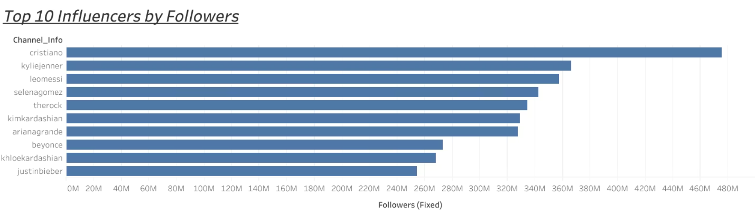
Top 10 Influencers by Followers
Key Insights
Business Implication
Follower concentration among a few influencers
Blend reach and engagement in influencer selection
Engagement rates vary across top followers

Slide 8
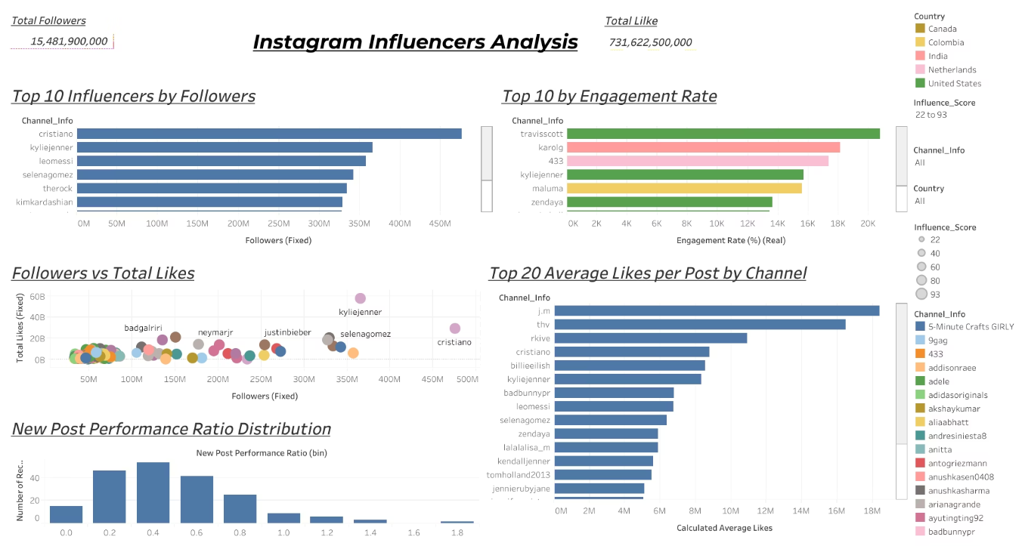
Dashboard Overview
Comprehensive view: activity, reach, engagement, demographics

Slide 9

Dashboard Insights
Fine-tune by engagement demographics & niches
Strategy must be Instagram-centric
Influencer activity and demographics aligned
Instagram highest reach and engagement

Slide 10
Key Business Observations
Consistent post-performance ratios overall
Engagement varies independent of follower count
Instagram leads in platform performance
Micro-influencers offer significant growth opportunities

Slide 11
Business Solutions
•Prioritize partnerships with high-engagement micro-influencers.
•Focus campaigns heavily on Instagram.
•Run experimental "viral content" campaigns to push posts into top performance brackets.
•Blend partnerships across different follower tiers to maximize both reach and engagement.

Slide 12
Conclusion
•Current influencer marketing strategies are solid but can be enhanced.
•Engagement quality matters more than follower quantity.
•Instagram should remain the key focus, with strategic diversification.
•Implement data-driven influencer selection and continuously monitor engagement trends.

Slide 13
Thank You!

